Slide 1

Hate Speech and Hate Network Detection
WARNING: Presentation includes profanity due to the nature of the project.
Jeetendra Joshi

Slide 2
My thesis in one sentence…
Proving that social media companies are monetizing wrong sources of information and hopefully, they will finally see how they should be doing their work.
Notes:
Here’s a brief summary of my thesis.

Slide 3
Motivation
Social media is great but we all know there is a fundamental problem. Everyone loves how easy it is to setup and use but what happens when the wrong person/people/group manage to influence many by spreading hateful thoughts?
We saw in October last year that "Facebook has been unwilling to accept even little slivers of profit being sacrificed for safety"^{[1]}
I wanted to see whether I could do something about it
Sources: https://www.bbc.co.uk/news/technology-59038506
Notes:
We all use social media on a daily basis whether that be Twitter, Facebook or even LinkedIn. It’s great and to some extent has taken over our lives however, there are a few individuals that can’t seem to use the platform properly spreading hate speech and violent views to other users which is clearly wrong. We also see that social media companies are clearly making a profit off of this and I felt like this was a challenge I could take on. So I decided to do something about this.

Slide 4
Problems with Hate Speech Detection
Hate Speech is large and varied
Cannot be done manually – We cannot monitor every social media post + we as humans have bias
Only detects one person at a time
Notes:
First of all there are too many problems with hate speech. These are just a few of the problems we can see. The main problem is that this such a large problem and there does not seem to be just one approach to dealing with hate speech. Further problems include that English is not the only language on social media and that people that hate user circles are often quite private and difficult to detect.

Slide 5
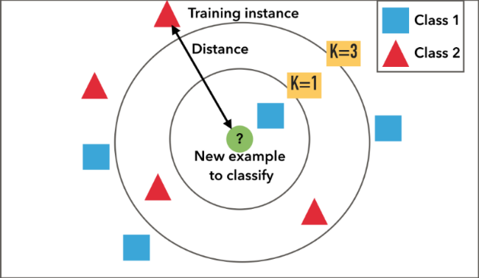
K-NNs NBSVMs
Combines a support vector machine with naïve bayes log-count ratios.
Naïve Bayes log-count ratios – probability a word appears in positive class versus negative class instead of word embeddings
Supervised Learning Algorithm – Data is prelabelled
Each sample looks at its K closest neighbours and its class is determined by the majority class of its K neighbours
Image source: https://medium.com/machine-learning-researcher/k-nearest-neighbors-in-machine-learning-e794014abd2a
Notes:
These were the first two models that were used:
K-NNs are a supervised learning technique. Each sample is labelled with a class label and assigned a value. Each test point that is evaluated has it’s class determined by the K nearest points. Have a K too small and you may misclassify through the presence of an anomaly. Have a K too large and the points further away will be considered. Picking the correct K is essential in determining the correct model.
SVMs work by determining a margin that can distinguish between different sets of data through determining a margin that segregates the data maximally. NBSVMs use this property combined with a naïve bayes calculation to determine the presence of a specific word within each class to determine the given boundary.

Slide 6
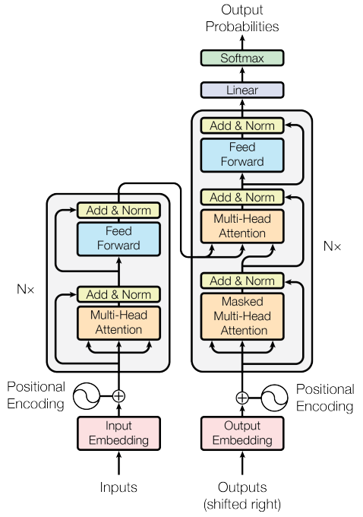
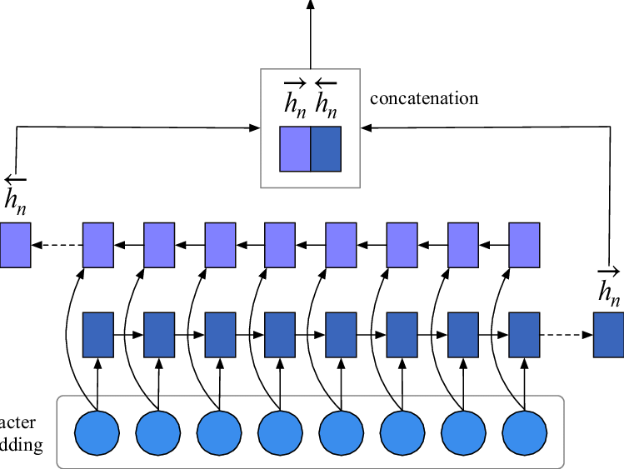
BiGRUs Transformers
Model that consists of two GRUs, one taking input in forward direction and other in a backwards direction
A GRU is similar to an RNN, but also contains an update and reset gate which determine the information passed to the output.
It looks at multiple input words to determine the output of the network.
Encoder- Decoder Architecture
Uses attention to denote key parts of an input sequence
Both position and context of a given input when outputting probability of an output
[1]
[1] Chinese medical question answer selection via hybrid models based on CNN and GRU - Scientific Figure on ResearchGate. Available from: https://www.researchgate.net/figure/Network-architecture-of-BiGRU_fig2_331459358
[2] Ashish Vaswani, Noam Shazeer, Niki Parmar, Jakob Uszkoreit, Llion Jones, Aidan N. Gomez, Łukasz Kaiser, and Illia Polosukhin. Attention is all you need. Advances in Neural Information Processing Systems 30 (NIPS 2017), pages 1–11, 2017.
[2]
Notes:
GRU modls are an extension of RNNs looking at multiple of the input words at a given time however, they combat the short-term memory problem by having two additional gates. BiGRUs utilise two GRUs, one working in with the input sequentially and one with the input in reverse.
Transformers are a DL model that weight different parts of an input data separately. They process sequential inputs but all the data is not input sequentially, but in parallel. The models I utilised were the BERT and DISTILBERT models.

Slide 7
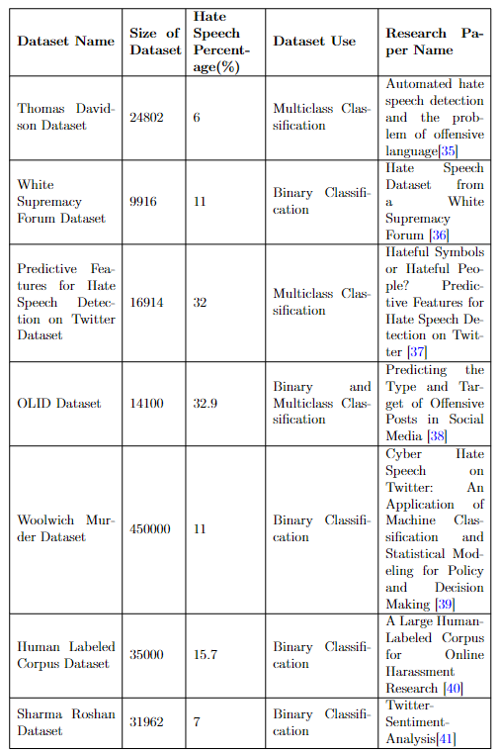
Dataset Collection
Looked at various publicly available datasets, mainly reading various papers and looking at sites such as hatespeechdata.com
Concluded on two datasets, Thomas Davidson dataset and Sharma Roshan Dataset
Notes:
Surprisingly, hate speech is readily available. Just through public datasets. Many datasets were evaluated looking at the techniques that were already applied and the percentage of hate speech in each of the datasets. The final decision was to use the Thomas Davidson and Sharma Roshan’s datasets. This was because many of the techniques applied in this project were not utilised in these papers so it would be interesting to see whether there were any better results that could be utilised.

Slide 8
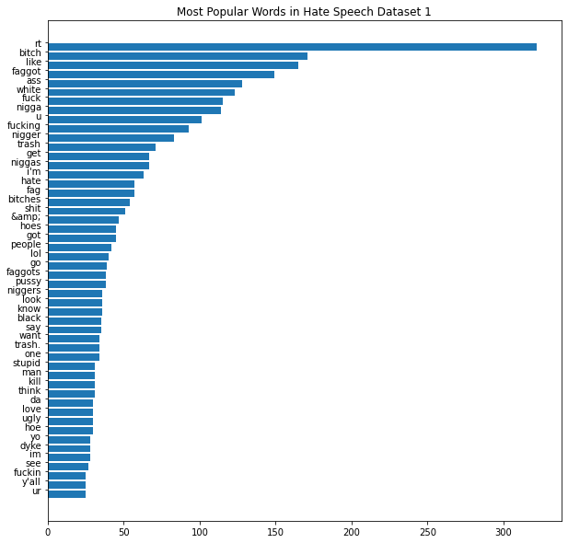
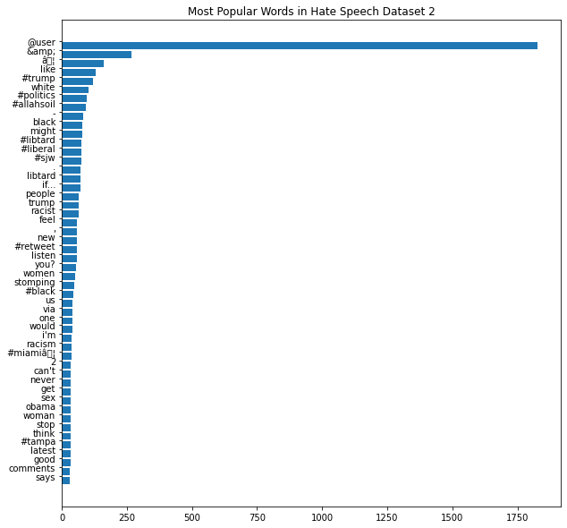
Text Analysis
Observed patterns in the data, more specifically each class
Found that certain terms were common in hate speech such as “@USER” tags and URLs.
Also, lots of profanity was found in hate speech terms (as expected)
Notes:
To help with both preprocessing and hate network detection, analysis had to be done on the data to determine what would help with optimally detecting hate speech. As expected there was a lot of profanity. Additionally, lots of hate speech seemed to contain many @USER terms and URLs. This was more interesting to find as these are not hate-speech specific terms but should be considered an interesting find. Additionally, this would help influence the words in the word lexicon later on for hate network detection.

Slide 9
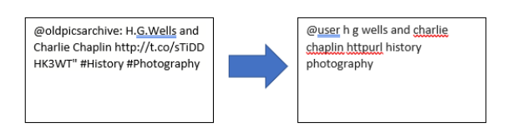
Preprocessing
Notes:
Before model development, the text was preprocessed to ensure that only useful data was input to the models.
This meant that the models would be learning the best possible information
Information Removed -> Punctuation other than exclamation points, question marks, commas and full stops
Information altered-> URLs and specific user tokens, hashtags were changed to just the word phrasing

Slide 10
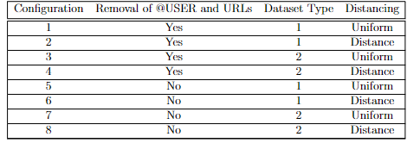
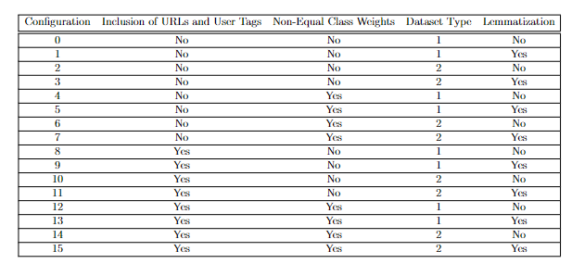
Configurations
KNN’s
NBSVM’s, BiGRU’s and Transformers
Notes:
Here are a bunch of configurations used with the KNNs and other DL models. The configurations denote the various types of preprocessing done to try to find optimal preprocessing methods. We begin with the KNNs. Let me explain the columns.
For K-NNs:
Dataset Type – Whether the dataset is balanced or imbalanced. A balanced dataset would have much fewer samples as there would be equivalent samples of hate and non-hate speech samples.
Distancing – Whether points are weighted according to their distances or whether all points are weighted the same as long as the are within the K Nearest Neighbours
Removal of @USER and URLS- whether all tags are changed to tokens or whether they are removed completely from every tweet
For BIGRUS:
The inclusion and dataset type are the same
Whether the classes are weighted according to their proportion within the entire combined dataset or whether there is equivalent class weighting
Lemmatization – Whether words are changed to their root words similar to stemming but in terms of the context within the sentence

Slide 11
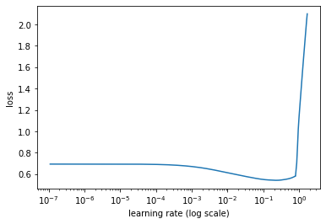
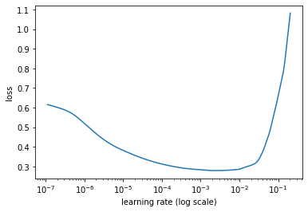
Model Training
Each model was trained with a triangular learning rate policy
Each model was also assigned a different learning rate determine by the lr_find function in K-Train
They were determined by looking at the value that resulted in the largest negative gradient
Notes:
Each model was trained with a different learning rate. K-Train helps to determine this through the lr_find function which helps determine an optimal learning rate through visual inspections of the graps provided. SHOW EXAMPLE. For example in this graph the steepest gradient is in the region between 10⁻⁶ and 10⁻⁵ .

Slide 12
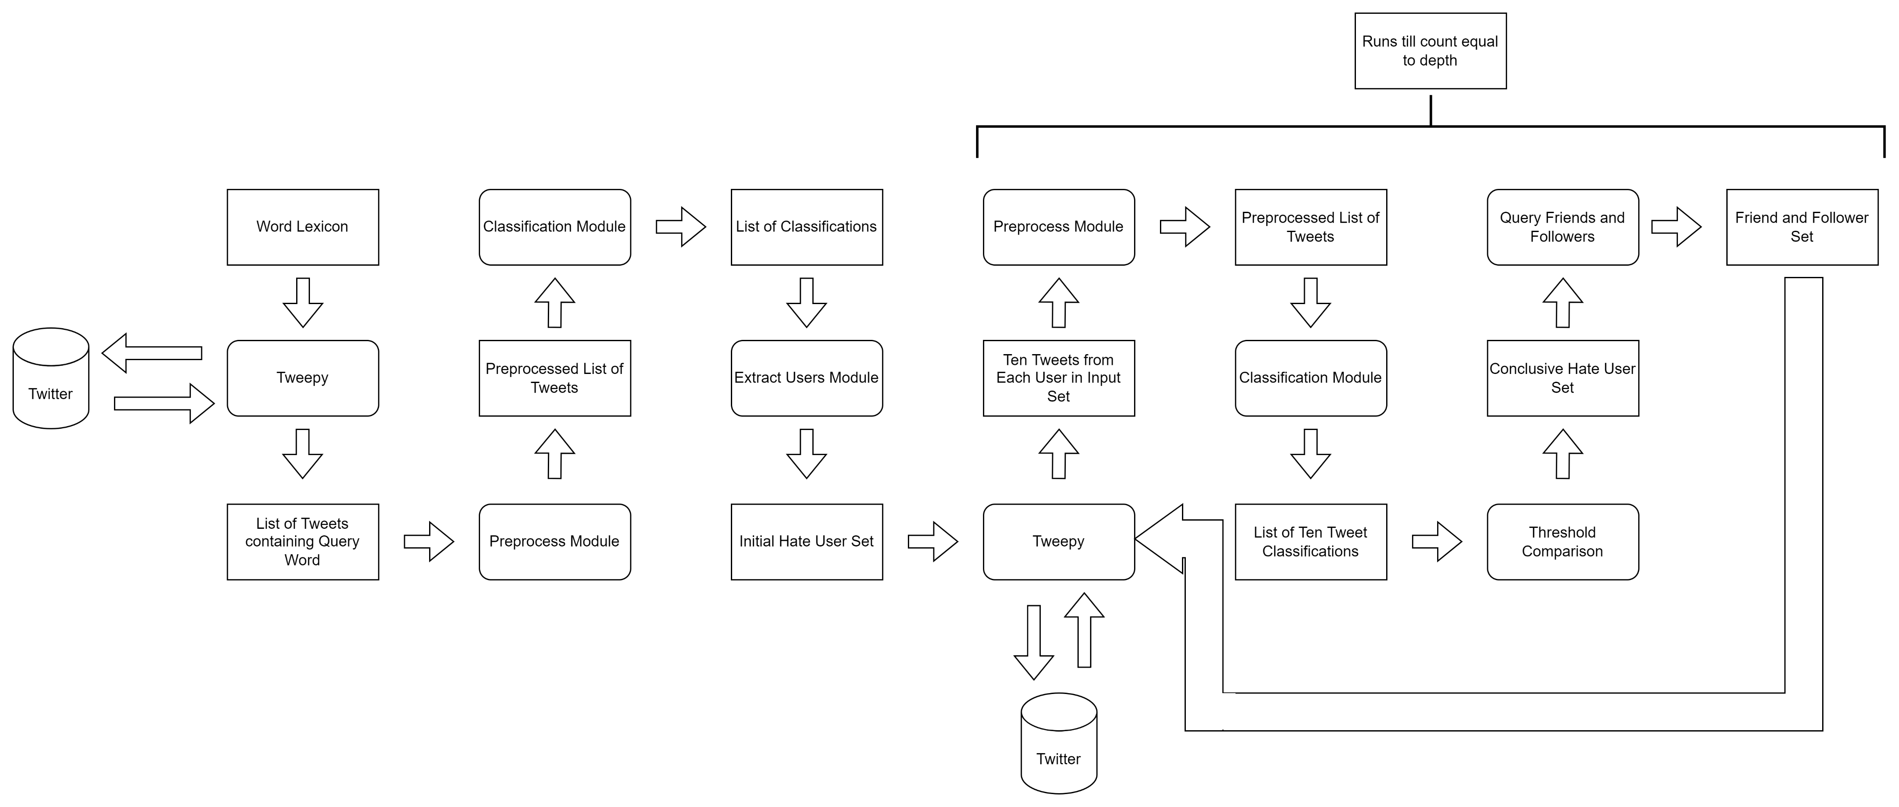
Hate Network Algorithm – PT 1
Notes:
We start with word lexicon that we found from the frequency analysis. This helps to narrow down the search of hate users. We then preprocess all of these tweets and classify them. This results in a list of classifications. If a preprocessed tweet is denoted as hateful, then we take the user in as a preliminary user for hate speech. But we must ensure that this is not a one off, or in the case of Twitter, notify that this has been flagged as hateful.

Slide 13
Hate Network Algorithm – PT 2
Notes:
The list of users has their last ten tweets queried from Tweepy. We preprocess and classify each of these tweets and we now end up with 10 classifications per user. We then evaluate whether the number of classifications that are hateful are greater than a developer defined threshold. If a user is denoted as hateful, they are added to the conclusive hate user set. They have their friends and followers queried and the cycle continues on to determine a hate network till a developer defined depth , d.

Slide 14
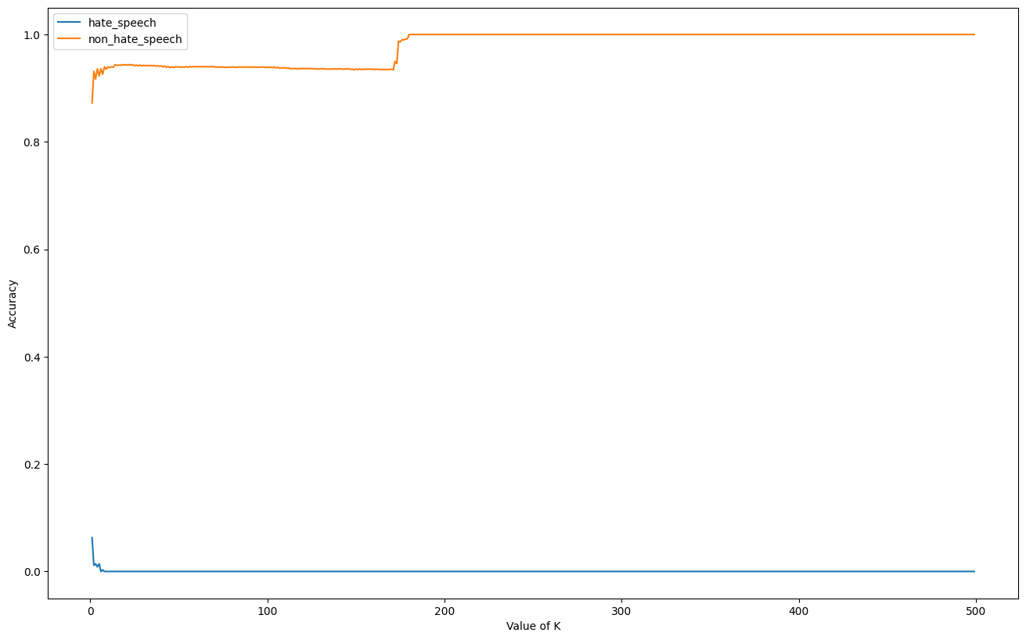
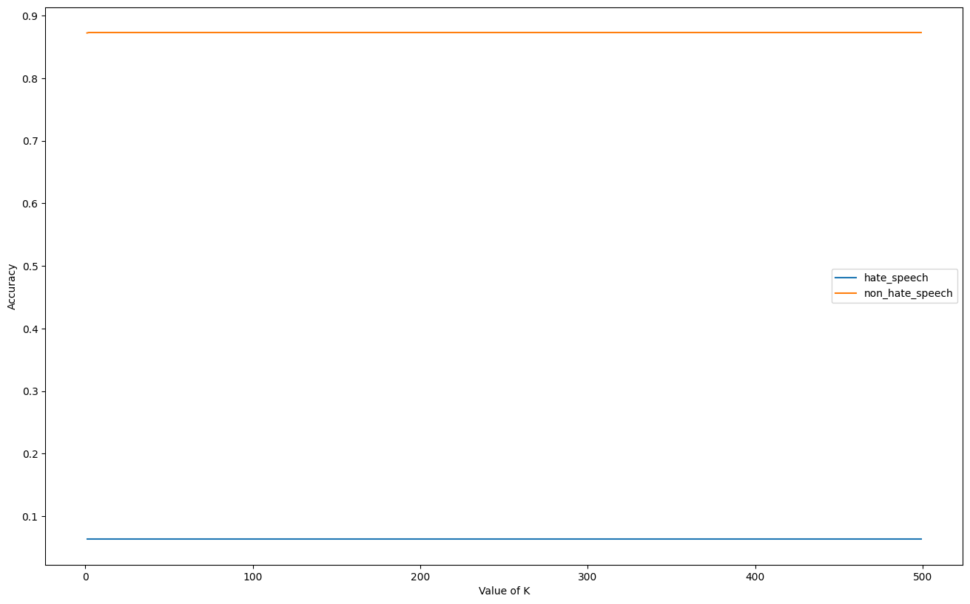
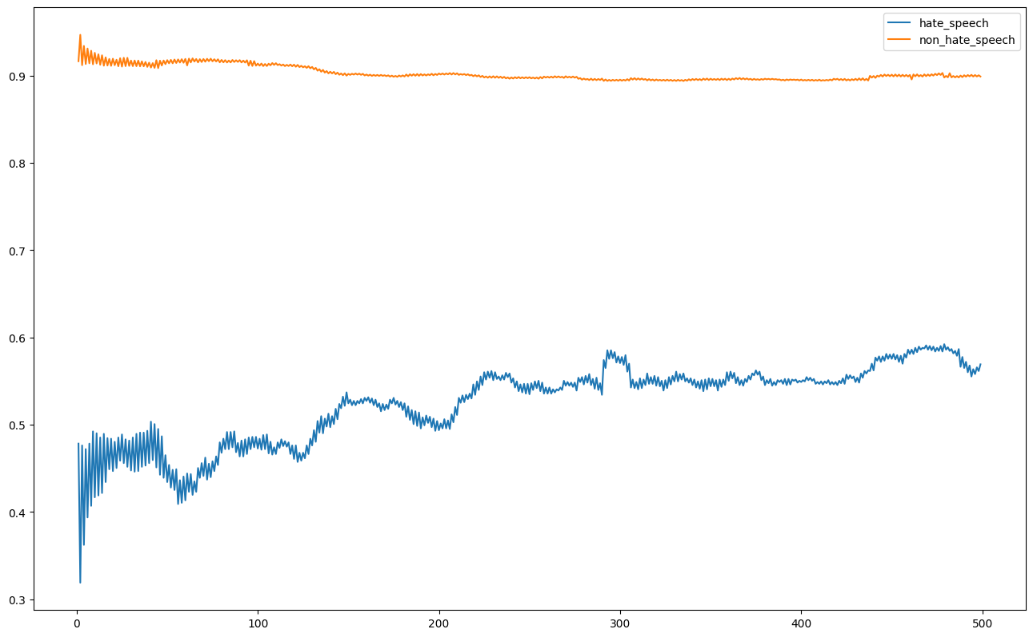
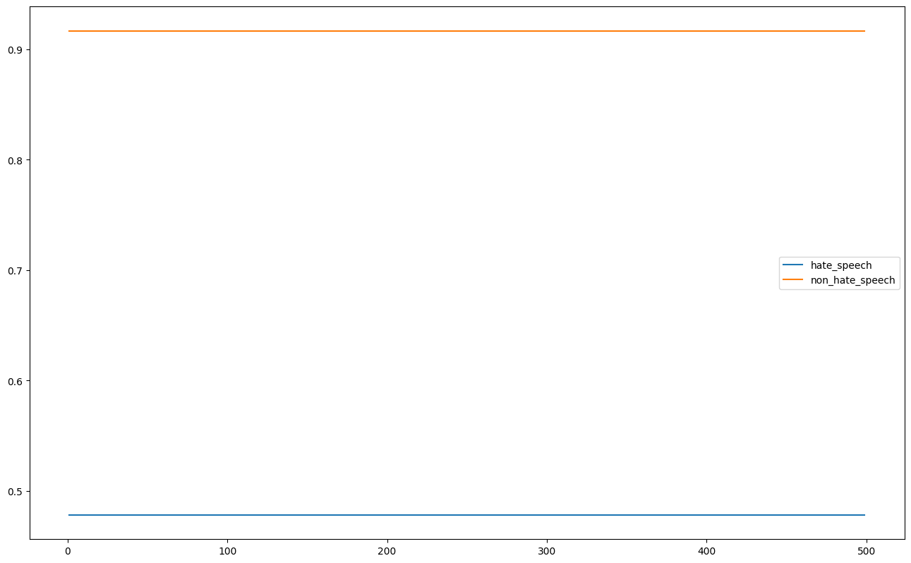
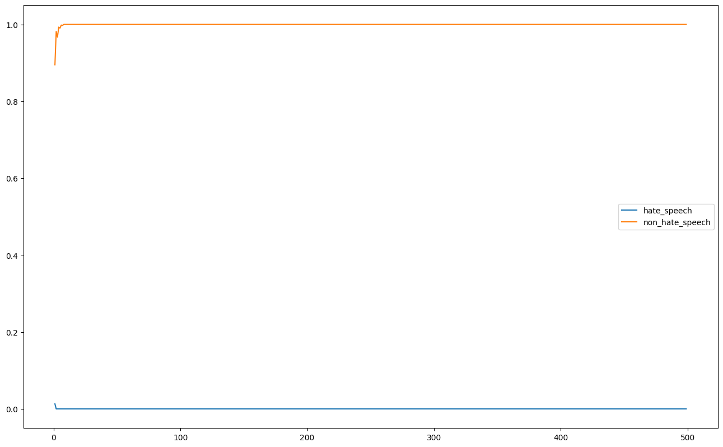
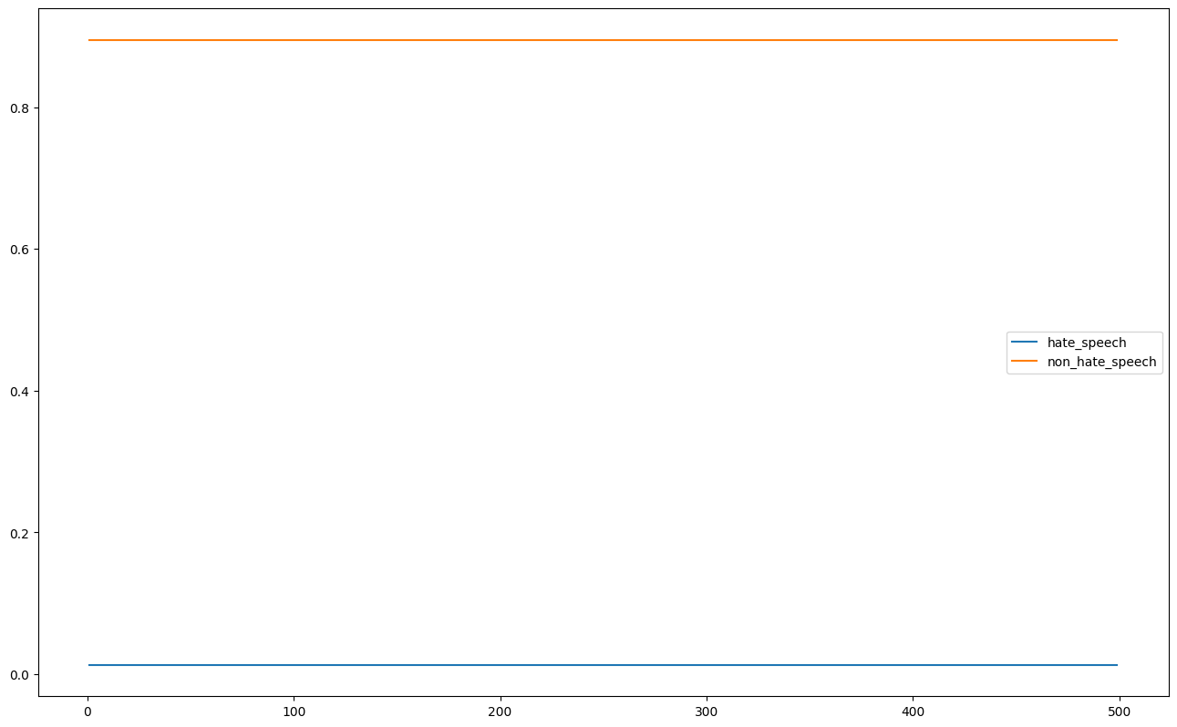
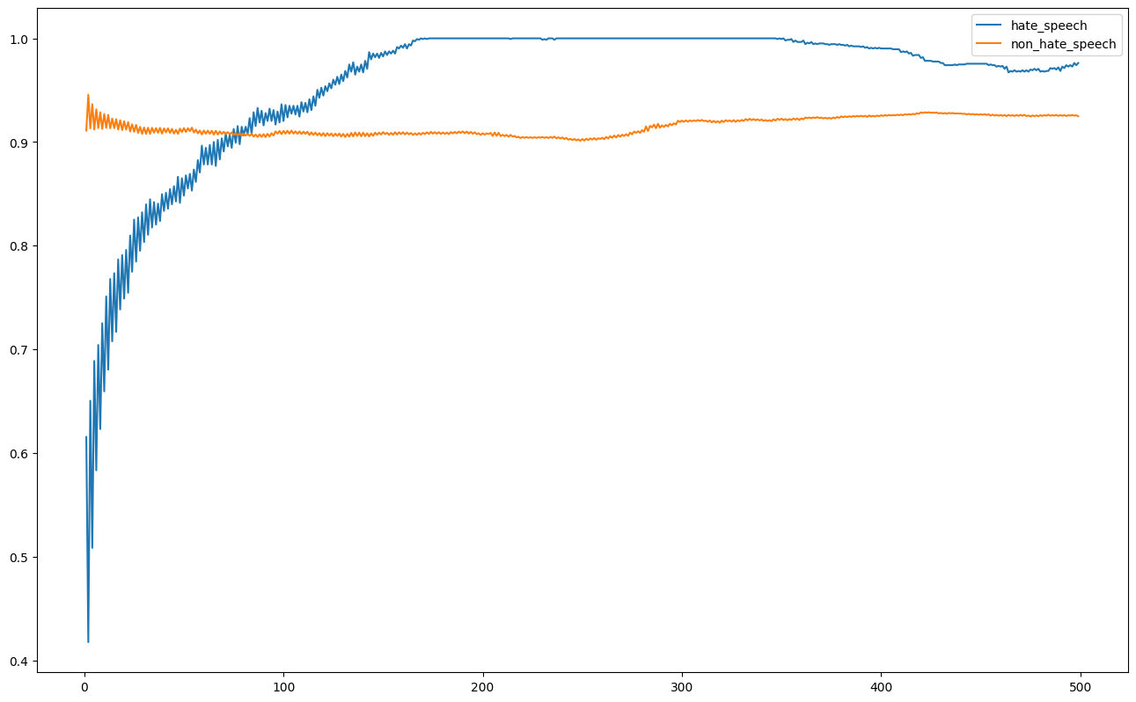
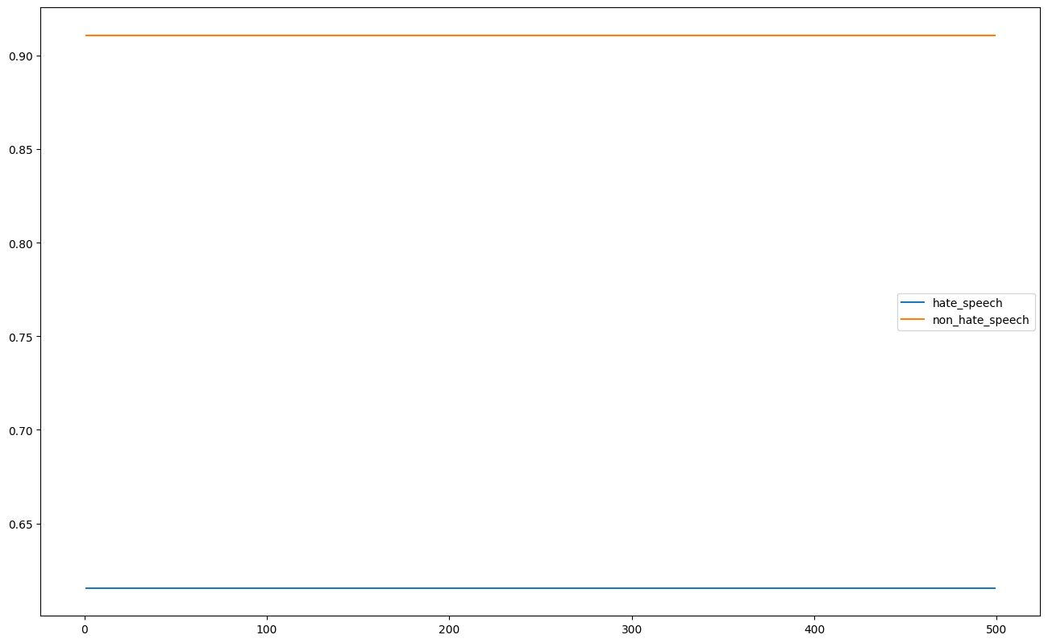
Testing – K-NNs
1 2
3 4
5 6
7 8
Notes:
Here are a bunch of graphs for the 8 configurations mentioned earlier on for K-NNs. Here are some key takeaways from the graphs:
Models with balanced datasets performed better than models without.(3 & 4 vs 1 & 2, 7 & 8 vs 5 & 6)
Generally most configurations showed that it there was no change in classification accuracy as K increased except for configurations 3 and 7 implying a relation between uniform distancing and a balanced dataset regardless of URLs and USERs
Removal of USER and URL tokens results in lower accuracies for both classes.
Overall it is very difficult to use a K-NN and only frequencies of words to distinguish hate and non-hate speech instances

Slide 15
Testing – DL Models
All the results collated in the form: True Positives| True Negatives| False Positives|False Negatives
Not very useful so they were converted to metrics resulting in tables
Notes:
Here is all the data that I collected for the DL models with the 16 configurations and 4 models over 50 epochs(except for transformer models). This wasn’t the best way to look at it so we made metrics out of said results per configuration per model per epoch.

Slide 16
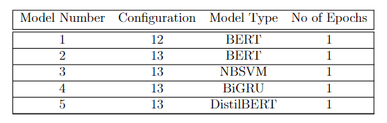
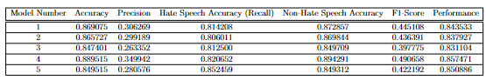
DL Methods Key Takeaways
MODEL DOESN’T MATTER -> All models performed similarly and the dependency was not on the model used, but the configuration used
The best configurations were configurations 4 , 5 , 12 and 13.
They all performed well at the PERFORMANCE metric: (Hate Speech Accuracy + Non-Hate Speech Accuracy) / 2
The models on the right were used as an ensemble for the hate network detector and further tested versus state-of-the-art models
Notes:
Each model performed similarly to one another. The big difference maker between the various models was the type of preprocessing that occurred. Current metrics aren’t very good for evaluating seriously imbalanced datasets so I created a new metric. I call this the performance metric which is the hate speech acc + not hate speech acc / 2. The best configurations across every model were 4 5 12 and 13. The common theme across these models was that they had an imbalanced dataset with uneven class weights when being trained.

Slide 17
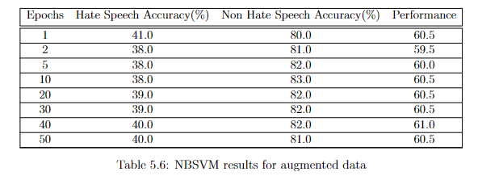
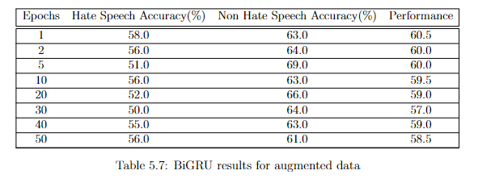
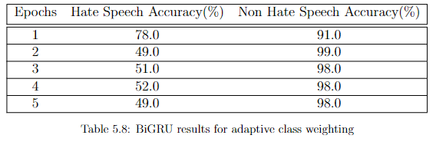
Failed Attempts
Data Augmentation: Attempted to change characters within the dataset to increase dataset size but contextual and position based data augmentation
Adaptive Class Weighting : Attempted to adapt class weight proportional to other classes’ accuracy but did not prove to be effective
Notes:
I tried two different methods to see whether I could improve the performance further. I tried data augmentation to simulate typos within the data similar to leetspeak. We also want the models to perform well at both classes so we tried adaptive class weighting to weight the opposite class proportionally to the accuracy of one class. Both these methods did not perform well. Data augmentation is not sophisticated enough and adaptive class weighting was not effective. Perhaps if a different method to weight the classes adaptively was applied it would work.

Slide 18
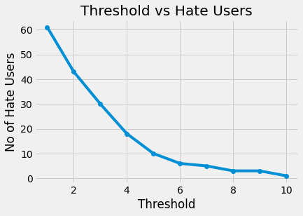
Testing – Thresholding for Hate Network Detection
As mentioned previously: we have a threshold we need to determine
We query every word in our lexicon and classify the tweets from every user to get an initial hate set -> 63 people
We look at each of those users’ past ten tweets and classify each of them applying a threshold from 1 to 10
We get a band at the bottom where there isn’t much change like an elbow plot shown in red. The value of 7 was chosen for this investigation
Notes:
As mentioned before with the hate network detector, we had to use a developer determined threshold. To determine this threshold every word was queried and classified similar to the initial hate network detection set. We then query each of their past ten tweets and classify each of them. We apply a threshold from 1 to 10 for each tweet and observe the number of users detected as hateful. This gave us this elbow plot with the band denoted in the red bar. We chose 7 as a safe value for the bar as the number stabilises at around 5 and we determined 7 to be a good value to keep a threshold at.

Slide 19
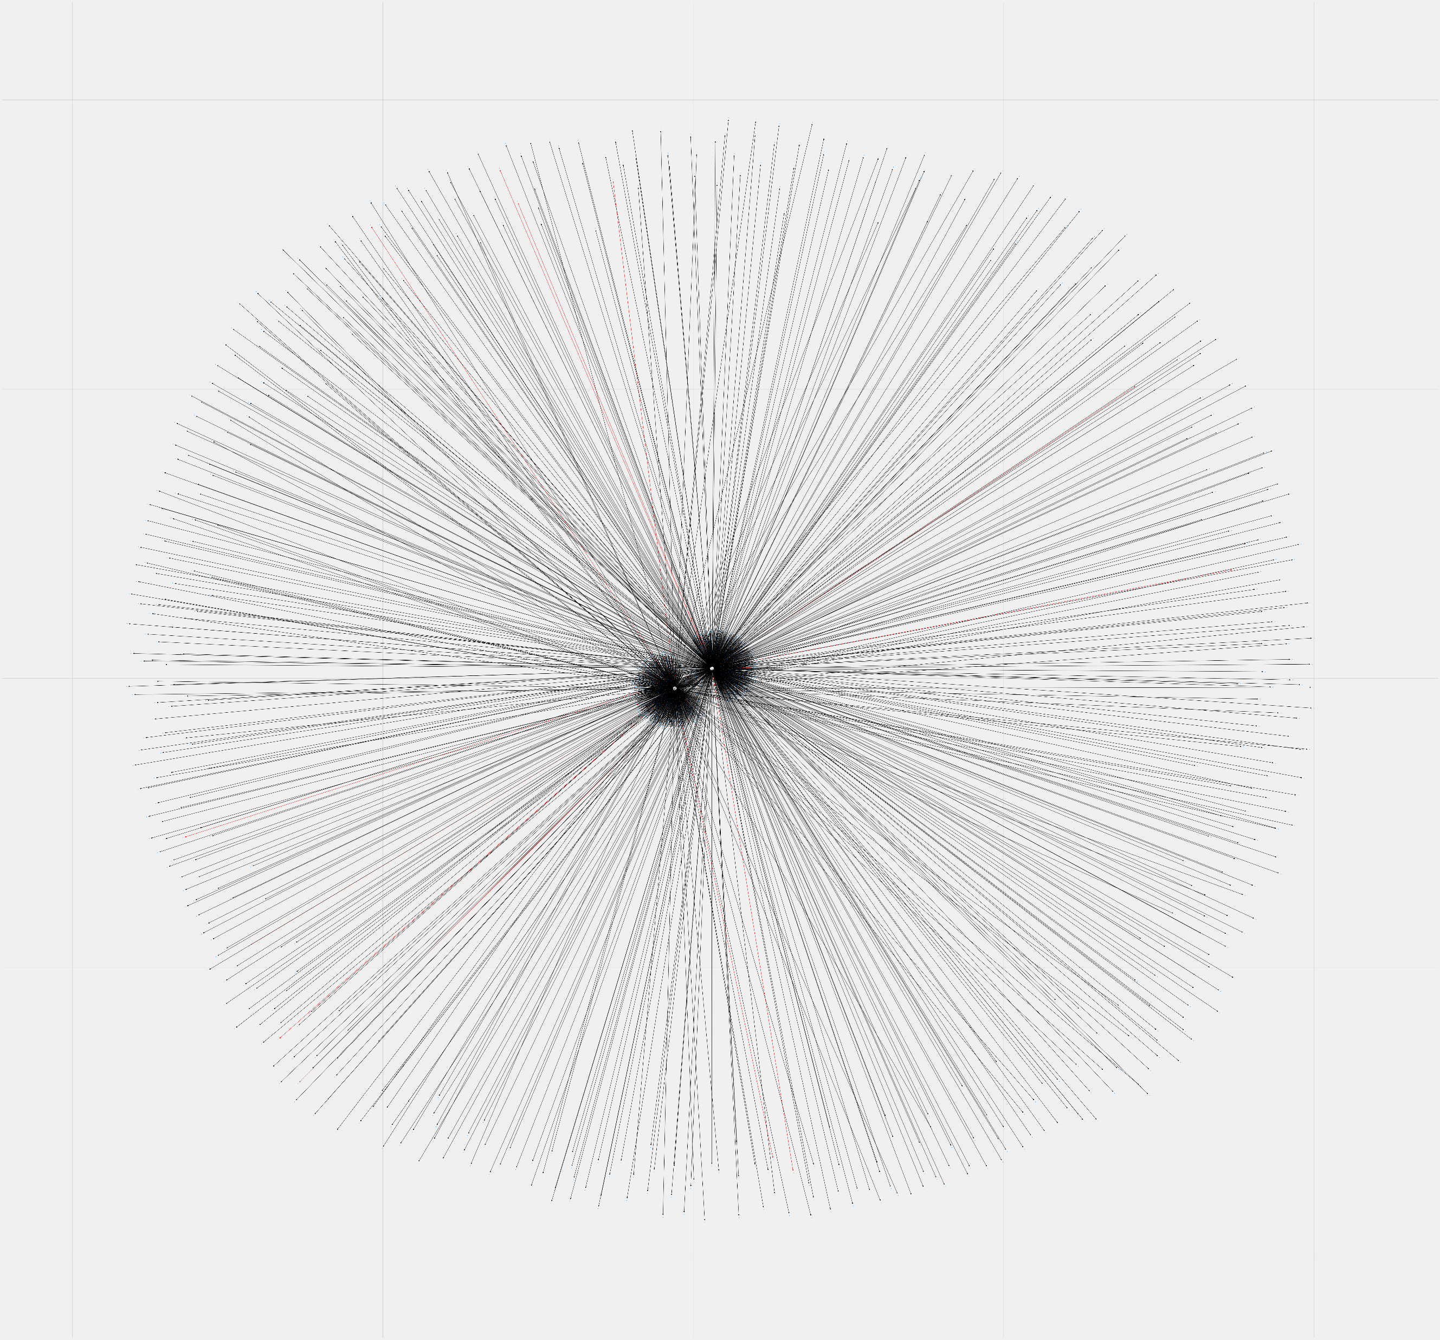
Testing – Hate Network Detection
With this, you get really cool images like on the right ->
This is a hate network detected by the algorithm. At the end of each line is a user. Red lines are connections between hate users.
Problem -> This only looks as 2 initial hate users, doesn’t go further than their friends and took 3.5 hours to generate
Notes:
We used this threshold of 7 to find a hate network. You get this really cool looking diagram and I’ll explain what it means. We see two main points with a bunch of lines coming out of it. The initial two points were the two hate users from the initial set. We looked at all of their connections. Each of these lines denoted a connection between two users. A red connection denotes connections between two hate users.

Slide 20
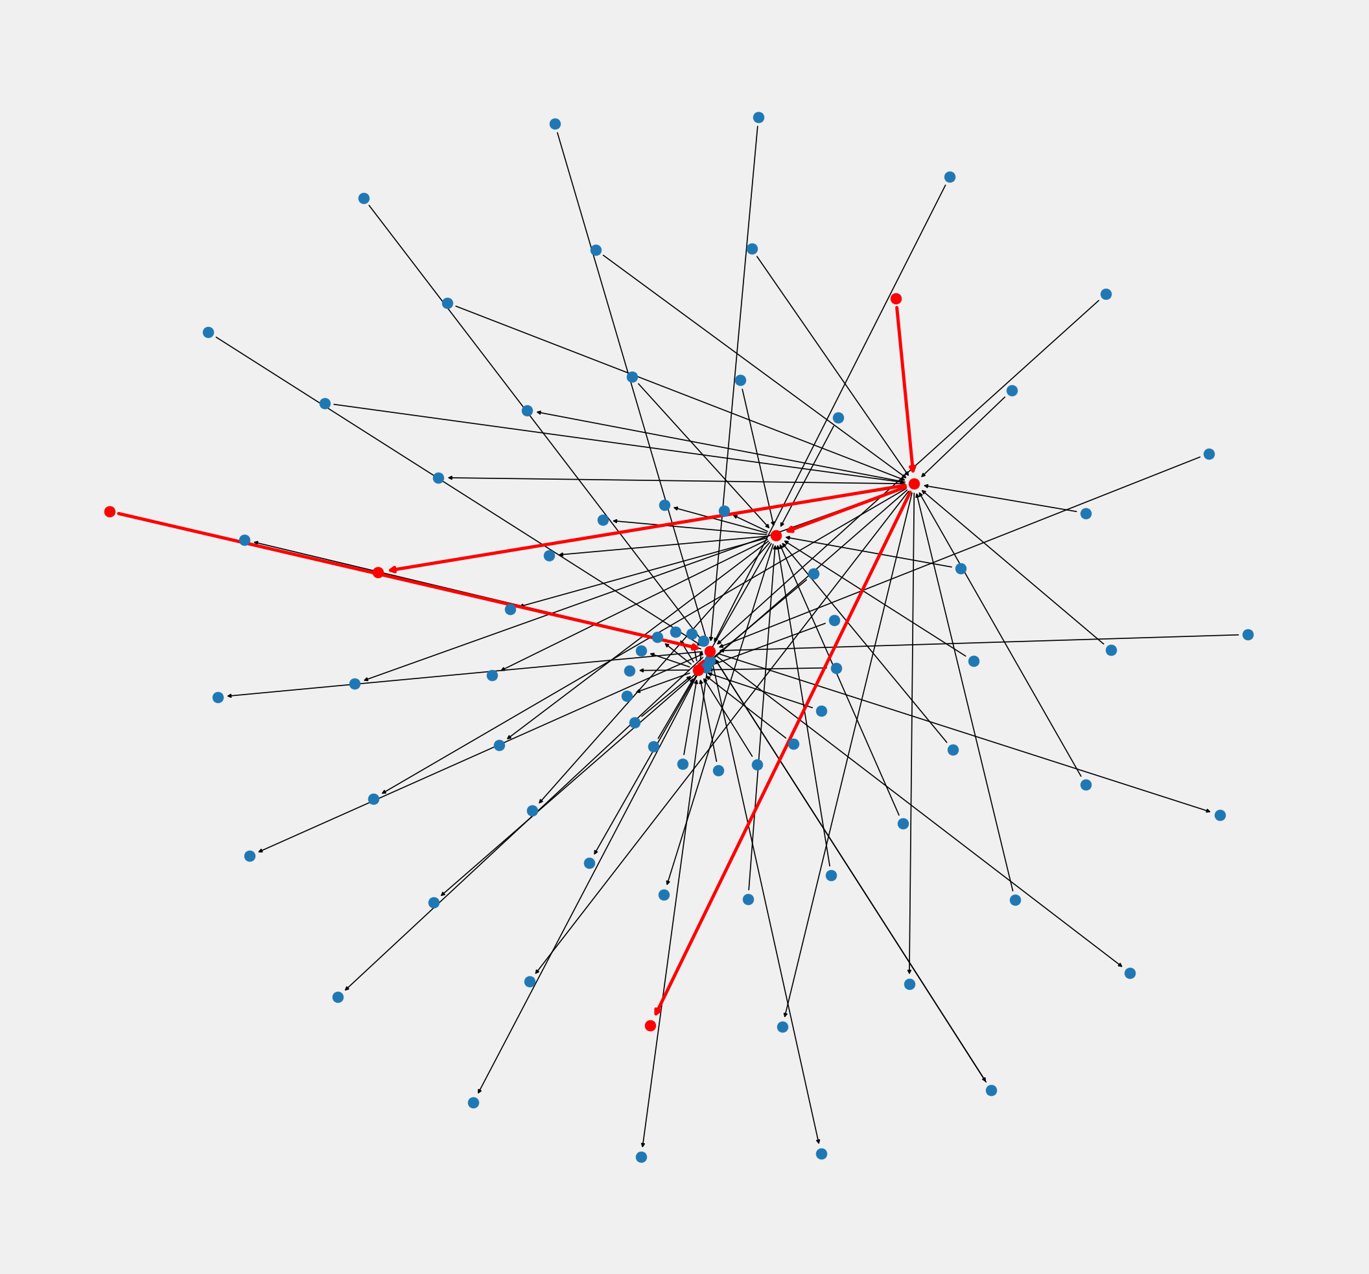
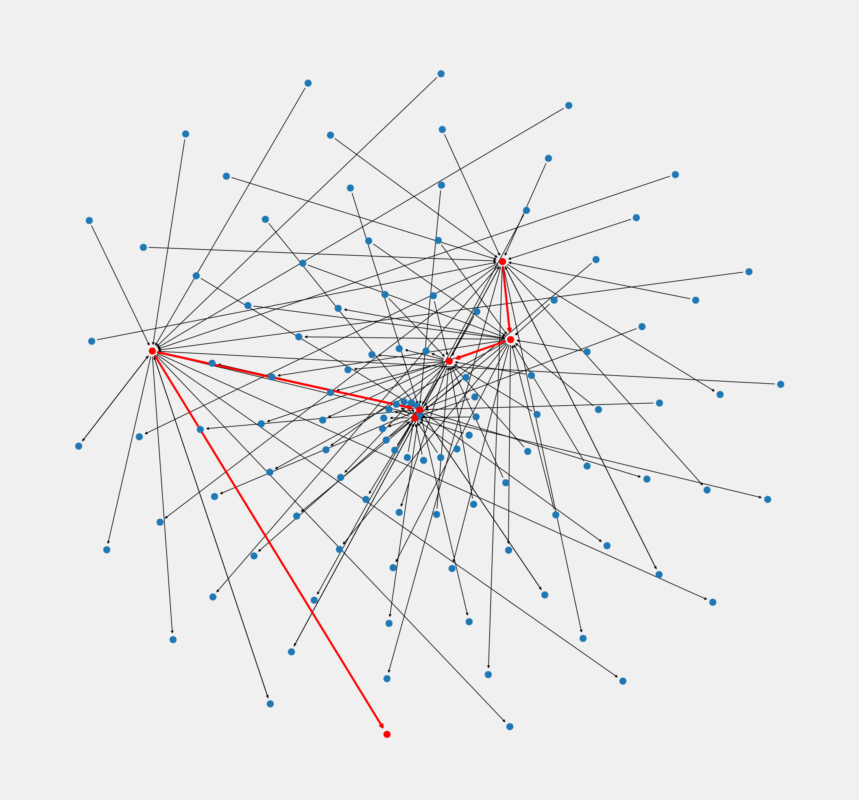
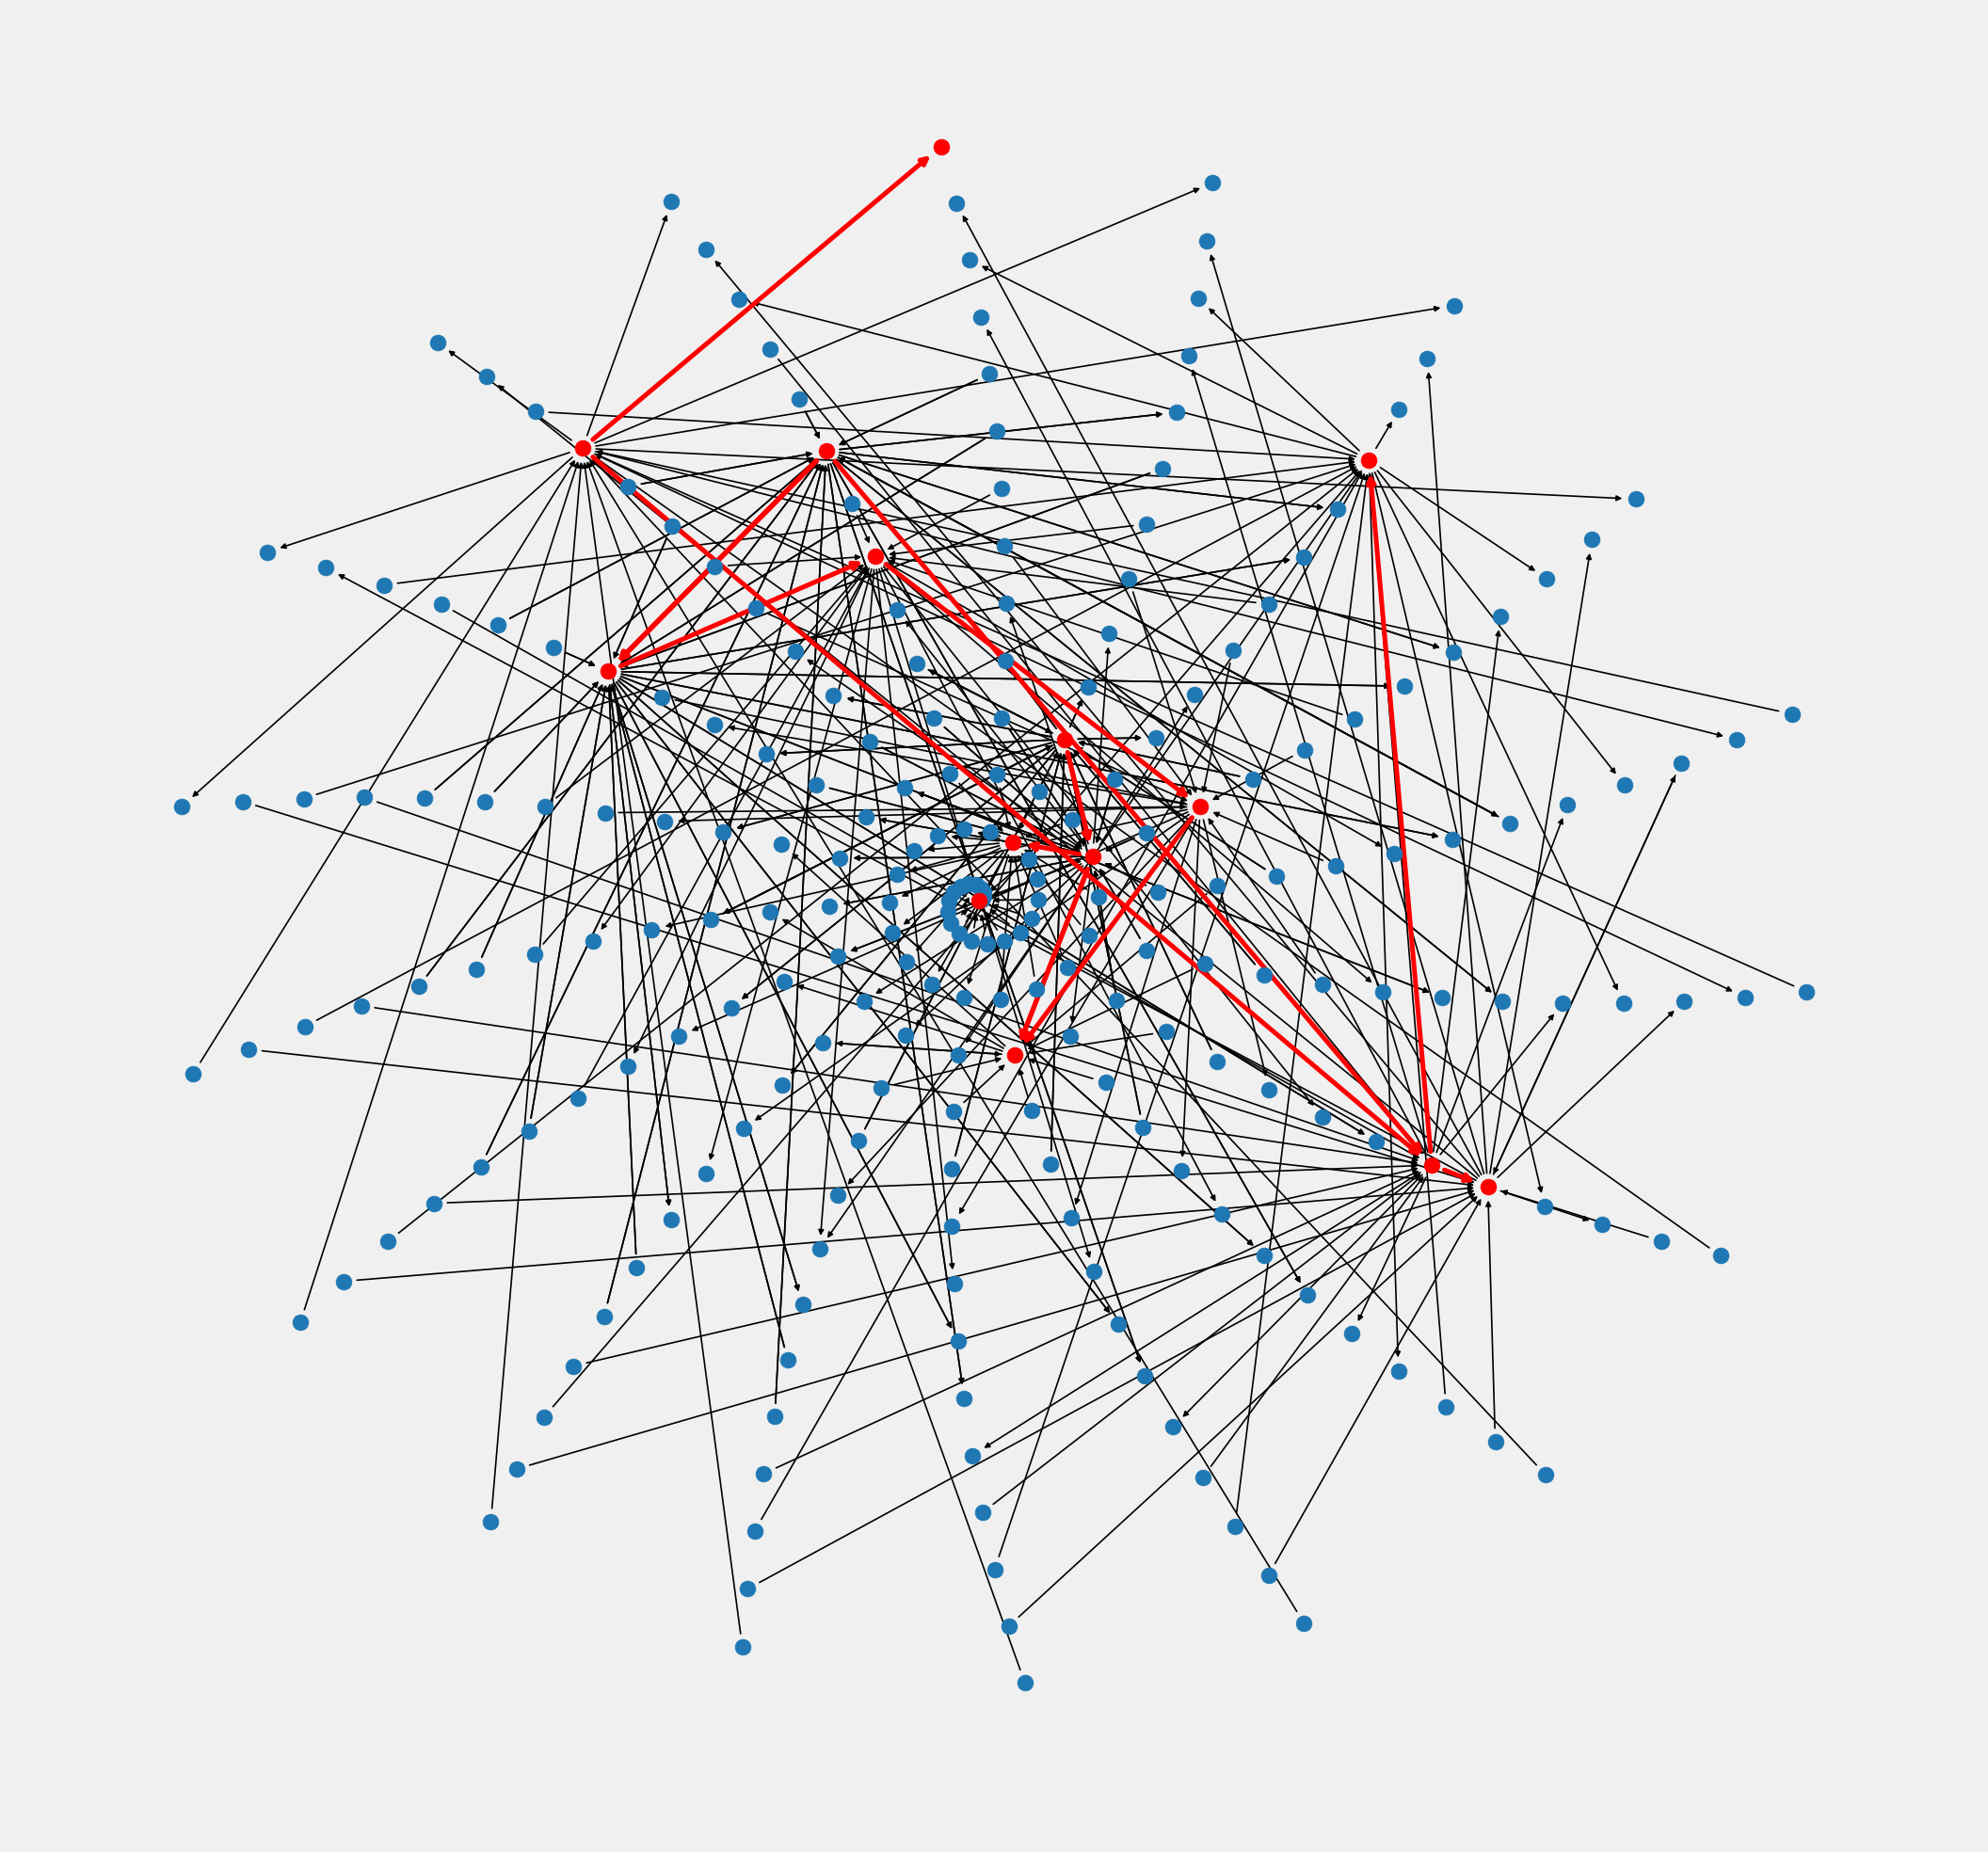
Testing – Hate Network Detection
Less friends and followers but we can go deeper (and it doesn’t take 3.5 hours):
Depth 3
Depth 4
Depth 10
Notes:
So we reduced the number of friends and followers and looked at the networks again. The direction of the arrow shows a user following another user and we are able to get much deeper now. We see that the number of hate users increased as the depth increased.

Slide 21
Conclusion and Future Works
Overall, models with >80% accuracy with classifying both classes and hate speech networks were detected .A hate network detection system was developed proving that more than one person can be detected from singular pieces of hate speech.
However, more work can be done such as:
Make it multilingual
Make it work on other forms of social media
Working with more datasets
Let’s hope Twitter will actually do something with this!
Notes:
This project was quite complicated but we got some great results, models with >80% accuracy for classification of both classes and hate networks were detected. More can definitely be done, we can make the model multilingual, work on images and be more diverse in the hate speech it captures. Hopefully Twitter actually does something with this!

Slide 22
Contributions and Key Takeaways
I know that this is a lot to take in from one presentation. However, just some of the key contributions include:
Identification of a large presence of non-hate specific tags within hate speech tweets
Effectiveness of preprocessing on classification accuracy of K-NNs
Investigation of 16 different preprocessing techniques for 4 different deep learning methods over 50 epochs
Development of an ensemble model that performs well at classifying hate speech and performs similarly to models developed in other papers
A novel method for detecting hate networks with a depth based hate speech detection system with the determination of optimal thresholding for classification of hate users
Notes:
If you weren’t able to follow and just got the gist of the project, here are some of the key contributions of the project

Slide 23
Questions?

Slide 24
NOTES
Notes:
REMEMBERWEIGHT DECAY == 0. FIND A REASON WHY

Slide 25
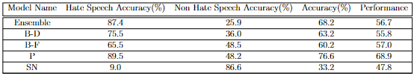
Our Model vs State-of-The-Art

Slide 26
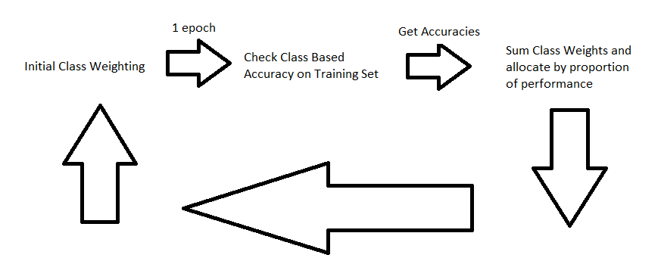
Adaptive Class Weighting

